Slide 1
Building FAMILIES THROUGH ADOPTION
WELCOME BACK!

Slide 2
SESSION 3: Homework Review
Homework: Synonyms for the Story Creating your language
Physical Abuse
Sexual Abuse
Neglect
Domestic Violence
Drug Addiction
Notes:
In the chatbox: Please enter in the examples that you created for synonyms of explaining physical abuse, sexual abuse, neglect, domestic violence and drug addition.

Slide 3
While you are waiting, please answer the following question. Post your answer in the chat box.
Question: How would you answer the question: “Who am I” in three short statements?
For example: I am an orphan. I am a billionaire, Bruce Wayne. I am Batman.
Notes:
Instructor: Welcome folks and ask people to read the assignment on the screen and put their answer in the chat box.
PROCESSING: As people define themselves, they typically use their relationships, their ethnicity, and their behavior or accomplishments. This is where often our children struggle as there can be a lot of confusion or missing information which can make it difficult when they are trying to understand who they are.

Slide 4
SESSION 4: Identity in Adoption
Notes:
Introduce session-- Review first three sessions: beginning connections, exploring grief and loss, and telling the adoption story. This session we are looking at issues in a developmental framework. We are building on the past sessions and now talking about identity issues in adoption and the different considerations parents need to think about.

Slide 5
Session Objectives
To explore the meaning of identity in the context of adoption
To encourage a positive self worth and identity in children who were adopted
To explore the role of race and culture in identity
To build skills in answering tough questions and responding to intrusive questions
Notes:
GIVE A QUICK OVERVIEW OF WE WILL TALK ABOUT
This Session will:
Explore the meaning of identity in the context of adoption
Encourage a positive self-worth and identity in children who were adopted
Explore the role of race and culture in identity
Build skills in answering tough questions and responding to intrusive questions

Slide 6
Questions of Identity in Adoption
1. What is my adoption story? Who am I? What happened to me?
2. Does my voice matter and have power? Is it safe to try and fail?
3. Who am I racially & culturally? What if I’m different than my parents?
4. How do I respond to others when they ask me about adoption?
Notes:
OVERVIEW of What We Will Cover today
Identity in Adoption Tasks– Our identity is made of up many things. For the child who was adopted, part of their identity is the experience of adoption and how it impacts them. This becomes part of who they are. Their identity will grow from the child’s own developing understanding of their story and from the people around the child. In this way, parents become very important in helping facilitate a healthy development of that identity.
We will cover four concepts tonight.
For healthy development, children and youth need to develop their own adoption narrative that gives them a story to answer the questions of who am I and what happened to me?
Part of our identity includes the impact we feel we have on the world. Because youth who experienced adoption also experience various kinds of loss, their identity will be influenced by their ability to feel that their voice matters, if they feel that they can try new things and fail, and even if they do fail that they will still be loved and supported.
An important part of identity are the messages we get about our racial and cultural identity. How is this handled in the adoptive family is especially important if the adoptive parents come from a different culture or race than the child.
Our identity is also formed from the people around us and the messages we get from them. So how will I be perceived by others, and how do I talk to others about my experience?

Slide 7
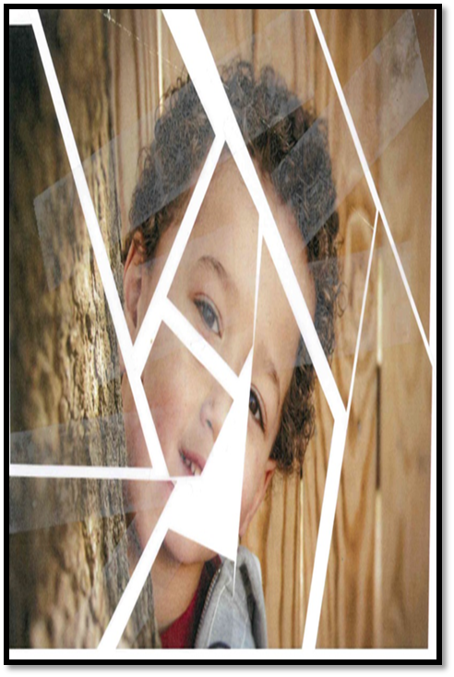
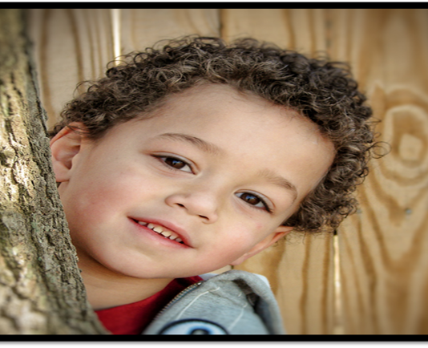
“The younger the child, the more powerful the negative influence is likely to be. The stronger the foundation of positive identity and sense of self-worth a child has, the more likely they are to overcome these barriers.”
Notes:
Adopted children face many barriers in their ability to develop positive identity.
They have likely experienced early trauma, which has impacted their ability to have secure attachments.
They may experience self-blame for their abuse and removal from their family.
They have internalized feelings of abandonment and rejection
They have likely experienced multiple moves between family members or foster homes.
As this quote says, “the stronger the foundation of positive identity and sense of self-worth a child has, the more likely they are to overcome these barriers.” The younger the child, the more powerful the negative influence is likely to be, which can then set the stage for troubling behaviors in adolescence.
Your job as a parent is to strive to help lay a foundation of positive identity and sense of self-worth. The firmer a foundation a child has, the more likely they are to overcome these barriers.

Slide 8
1.
What is my personal adoption story? Who am I and what happened to me?
Notes:
So, let’s look at each of the questions we have identified and discuss what your response as an adoptive parent can be to help a child or youth.
The first questions we identified is the child’s search for the answers to “What happened to me? What does it mean that I am adopted? Who does it make me now that I started in one place but am now here? What is my own story and how am I to understand what that means?”

Slide 9
Developing My Adoption Story
Notes:
The first task of healthy identity development we are going to look at is that of a child’s story or what is also called an adoption narrative. Children and youth develop their own adoption narrative which gives them a story to answer the questions of who am I and what happened to me?
In our last session, we dug into Mara’s story and explored how the language of the adoption narrative can positively or negatively affect a child’s understanding of these identity questions. You also had the opportunity to hear a re-telling of Mara’s story at three ages to have examples of how parents can facilitate this development of their adoption narrative.
The handout we shared in our last session: ADOPTION ACROSS DEVELOPMENT will help you remember the tasks at the identity/adolescence stage.

Slide 10
Adoption + Adolescence = IDENTITY CRISIS
i·den·ti·ty cri·sis /īˈden(t)ədē ˌkrīsis/
- period of uncertainty and confusion in which a person's sense of identity becomes insecure.
Notes:
INTRODUCTION:
In Erickson’s Stages of Development, adolescence is a time of exploring and establishing identity. The experience of having been adopted can complicated this stage. Teens who were adopted need to integrate all of the experiences of their life and often multiple differing messages into a cohesive puzzle that makes sense to them. Teens who were adopted have two, and sometimes multiple, sets of parents as reference. They may have had multiple placements in foster care, group homes, or treatment programs, all of which have influenced their sense of self and sent different messages about norms and values. They may or may not have a relationship or connections with their birth parents or other relatives.
Chat Box Activity
Ask participants to answer the following question:
Who or what did you want to be when you were in your teens? WRITE IN THE CHAT BOX
DISCUSSION POINTS:
Probably, you are different than you were at 14. You tried on identities and experimented with identities different than your own to see what fit. Although children and adults are continually working on identity throughout their lives, from the developmental perspective, the main focus of adolescence is identity exploration and formation. So for adopted teens, the questions of What Happened to Me? And Who Am I? are especially important during the teen years and for adopted teens, may be a difficult time as they seek these answers.
This identity exploration can be scary for parents as their teens “try on” different music, clothes, hair styles, friends, habits, etc. and teens can be sensitive to any judgement, real or perceived, from their parents. Parents can be curious and explore with their teen what they like/dislike about things they are trying on to encourage that communication and continue to send a message of love and acceptance.
This is often the time for adopted youth when searching for birth parents or other relatives comes to the forefront as they are seeking to understand and connect with where and who they came from. Adoptive parents have a powerful opportunity to connect, support, and bond with their teen by joining with them in their exploration about birth family. By engaging in the process with them, the youth do not have to go through a sometimes emotionally challenging process alone, and the adoptive parents can be proactive in making sure any contact that does occur is safe for the youth. The youth are also able to feel secure knowing that it is okay to love both their adoptive parents as well as their birth family.
An important concept to work toward is to remember that children and youth do best when they have a coherent narrative or adoption story. For some of our children and youth, this story is complicated because there are many missing pieces.

Slide 11
Who am I? The WHOLE story, not the HOLE story.
Notes:
MAIN POINTS:
Multiple moves have interrupted their developmental stage each time and has resulted in a lack of continuity in relationships. Each family has different values and expectations and can make things confusing for a child to figure out who they are. It is hard, if not impossible, to have a solid sense of self without a clear coherent picture of the past and the important people and events in your life.
For many of our kids, their history looks like this, huge pieces of their story are missing. Our job is to fill in the missing pieces to create a complete picture. If there are missing pieces, the child’s imagination will fill in the blanks with what makes sense to him/her.
We should not “sanitize” or hide the ugly hard pieces of their story. The goal is to provide truthful information in an age appropriate manner. Our jobs is to fill in the pieces, it is the child’s work to figure out how they feel about the events of their lives and the people in it.
Additional barriers also impact on the development of identity, causing the child or youth to come to terms with the experience in relation to one’s own sense of self. Many of our kids are in survival mode so they don’t stop to consider who they are, they are focused on how they are going to survive.
Your role as an adoptive parent? Help your child or youth develop over time a coherent narrative of “what happened to me” that includes talking about losses, allowing grief, building a solid identity, and developing relationships that are built on trust and attachment.

Slide 12
Question:
Where can families get the information to fill in the pieces of their child’s story?
Post your answer in the chat box.

Slide 13
Filling in the Missing Pieces
Disclosure Meeting
Caseworkers
Guardian ad Litem
Client History Profile
Former Foster Parents
Current and Past Service Providers
Notes:
Getting your child’s information and background is key to this step. Those missing pieces might be in different places. As you move toward adoption, consider these sources to find out the extent of your child’s story.
Disclosure Meetings—ask for these as you move toward finalization. This is a meeting where the caseworker will share parts of the file with you including the medical history and the case history of the child
Caseworker
Guardian ad Litem (often with the case the longest. Also must give permission for release of mental health records)
Client History Profile (This is a printed history of medical appointments paid for by Medicaid.)
Former Foster Parents
Current and Past Service Providers
As you move toward adoption, contact ACRF for the Adoption and Disclosure Guide we developed to help families get the information they need.

Slide 14
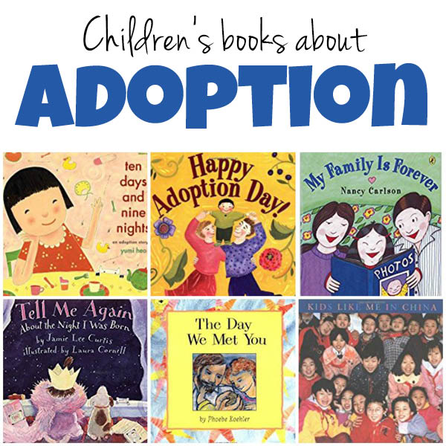
Tools to Help with the Talk
Adoption in Movies
Superman
Ninja Turtles
Star Wars
Batman
Martian Child
Despicable Me
Instant Family
Angels in the Outfield
Blind Side
Spiderman
Secondhand Lions
Juno
Notes:
Refer to HANDOUT 4-2: Adoption Resources for Parents
Filling in the missing pieces is getting the information about the child’s story. But kids need help to understand how they feel about their adoption story. There are terrific resources available to help explain adoption and talk about the feelings associated with adoption. Many of the book selections on the slide are available through the lending library of ACRF.

Slide 15
2.
Does my voice matter and have power? Is it safe to try and fail?
Notes:
The next question is “Does my voice matter? Will anyone ever listen to me? Do I have any control over what happens to me? Is it safe to have preferences, or try things? If I mess up, what will happen to me? Will someone help me be successful?”
If you recall our Erikson’s Stages of Development, Mastery and Control is a development task that coincides with early childhood. In healthy development, this is the stage we begin to understand that we can impact the world, that we can try and fail, and someone will support us and help us pick ourselves up and try it again. Our identity includes the impact we feel we have on the world. Because youth who experienced adoption also experience various kinds of loss and moves that they have no choice in, they may not feel a strong sense of control over their lives. This experience complicates their development in this area. Poorly nurtured and traumatized children learn that their wills are violated, and their wishes don’t matter. Like a “ball in a pinball machine” they feel powerless to control the direction of their lives and protect themselves.
READ THIS QUOTE FROM THE MOVIE REMOVED. “Removed” is a movie that is easily found on the Internet that tells the story of a young girl placed in foster care away from her only sibling and who has moved several times in the process. At one point in the film she says,
“I know I’m helpless, dependent, and desperate. But what happens when those you need the most threaten your very existence? I have heard plenty of promises, and they all sound the same. But push hard enough and sooner or later they all prove to be empty.”
These words illustrate of how children and youth feel like their voice is not being heard and that they have no control in the world.
When any person has lost control or in a chaotic environment, we seek out “something” to grab onto to give us the sense of control. I must be “in charge of something.” Kids will fight for control over everything, especially food/eating issues, or bathroom issues, or sleep issues, because those are a few of the thing's kids have control over. So, what is seen as a behavior problem may actually be an expression of needing to feel in control of something in their lives.

Slide 16
Developing Mastery and Control
Notes:
How does a child usually develop mastery/control? They start gaining mastery over several stages of development.
We are going to do an activity next to discuss ways that mastery and control is developed.

Slide 17
Question:
What are some ways children and youth may demonstrate mastery and control during:
Infancy
Toddlers/Preschoolers
Grade School
Adolescence
Post your answer in the chat box.
Notes:
CHAT BOX ACTIVITY: Ask the group to give some examples of children and youth demonstrating mastery and control for each age group (Infancy, Toddlers/Preschooler, Grade School, Adolescence)
Common mastery might be
Infants: sleep through the night, communicate to a caregiver, rollover, sit up, begin to vocalize, mimic facial expressions, point
Toddler/Preschooler: toilet training, learn to feed self, begin to express preferences, master strong emotions, learn to play, learn to play with others, beginning fine motor and mastery of drawing and coloring
Grade School: Mastering gross motor skills through group activities and team sport, building and experiencing friendships, learning what is interesting to them, mastering reading, math, and problem solving,
Adolescence: Beginning to master separation from family, peer relationships, friendships, mastering experiences in intimate relationships, mastering topics of interest at school, learning to drive,
MAIN POINTS:
Each of these points of mastery also depend on mastery of the previous stage.
A toddler must feel safe in a family to investigate and master (control) their environment. “Me do it!” This is beginning of competence. “I can do it myself” and “I don’t need your help,” is a common refrain.
Young children perform, and look back for the pride/ applause from their family. “Watch me, watch me, you need to cheer for me!” This normally develops in a trusting and safe relationship with parents. Children can feel free to explore only when they ‘trust” they will be safe and someone is looking out for their safety. The child has a secure base from which to explore and master his /her world.
Within boundaries, as the child gets older, they get more freedom to develop mastery and more practice with control. Such as, staying alone in the house, walking through the neighborhood, driving, etc.
Parenting through the teen years is like flying a kite. You maintain a tension between a youth who wants to fly free and explore beyond the boundaries, against the parent who is trying to harness and guide them to keep them from crashing. For youth who have experienced early trauma and loss, they often have been loose with too much freedom and responsibility for themselves so there can be a lot of tension trying to reign them in.
A child from a trauma background needs responsive and attuned parents to help them develop this sense of control over their own lives. Children and youth’s identity will be enhanced if they can grow in their feeling that their voice matters, that they are valued, and that they can grow and fail, and still be loved and supported.

Slide 18
3.
Who am I racially and culturally, especially if I am different than my parents?
Notes:
An important part of identity are the messages we get about our racial and cultural identity. How is this handled in the adoptive family is especially important if the adoptive parents come from a different culture or race than the child.

Slide 19
Developing a Healthy Cultural, Racial, or Ethnic Identity
Notes:
Refer back to introductory activity. We all have cultural and ethnic identities that are passed down from our families. You may not have thought about culture, but that is an example.
One of the important roles of families is to teach children the values and expectations of the world that the children live in. These values of who we are and what we believe in this world is influenced by the culture we live in. Our racial and ethnic identity also influences how we see ourselves in the world and how others see us.

Slide 20
Cultural, Ethnicity, and Racial Identity
Notes:
Race is determined by heredity and refers to a system of classification of humans based on physical characteristics. We sometimes refer to it as a “color” such as white, black, or yellow, but those are very inaccurate labels. Many more people these days are identifying themselves as multi-racial. Even people of the same skin color can have a wide variety of values, characteristics and experiences.
Ethnicity generally refers to a classification of people based on regional origin or nationality such as Irish, German, Nigerian or Chinese.
Culture is much more complex than ethnicity or race. Culture is a system of values, beliefs, attitudes, traditions and standards of behaviors that are generally accepted by a group. Culture is handed down from generation to generation, sometimes by explicit teaching and sometimes by exposure and modeling. It may be related to race or ethnicity, but can also be related to socio-economic class or regional location, or religious affiliation.
All of us have racial identity and cultural identity. We get messages from our parents about what these are but mostly we watch and model and absorb the cultural influences, thoughts and behaviors by watching people around us.

Slide 21
Positive Racial Identity
Notes:
INTRODUCE VIDEO: This video briefly addresses the issue of transracial adoption and the role of the parent in helping children develop a healthy racial identity.
SHOW VIDEO:
https://www.youtube.com/watch?v=LTZwUks_wFE
CHATBOX DISCUSSION QUESTION:
Was there anything that surprised you or make you think?
POSSIBLE DISCUSSION QUESTIONS:
What did you think of the ideas presented in this clip?
Was there anything that surprised you or made you think?
What might you need to learn if you were parenting a child who was of a different culture or race than you?

Slide 22
Post your answer in the chat box.
Question:
What can a parent do to promote a positive racial identity for their youth?
Notes:
So, what else can adoptive parents do to help develop positive racial or cultural identity in their children even if they are of a different race or cultural than their adopted children?
Parents can prepare their children for situations which they may experience prejudice/racism, so the youth feel prepared to respond. Validate their experiences and don’t be afraid to talk about how to handle these situations and how to keep safe.
Being a multicultural family may include the schools they attend, churches you attend as a family, and activities you participate in, and the professionals you see for services.
Exploring traditional foods can be a fun experience as a family. This is where connecting to individuals from your child’s culture can come in handy as you cannot purchase whale, seal, and walrus from the store (for example).
Prepare your environment to reflect the child’s race and culture. Does a child see themselves reflected in the images around them? In magazines, television programs, dolls.
Look for superheroes and heroines who reflect images that are positive, strong and capable.
Find role models in the community that share the same race or culture. Develop relationships of mentorship.

Slide 23
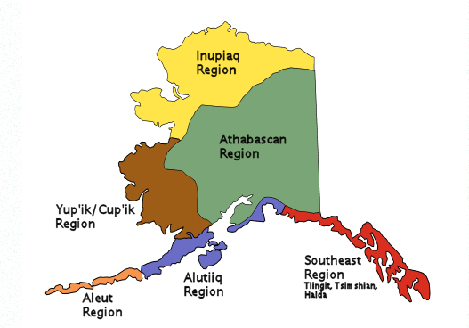
Alaska Native Tribes and Cultures
Notes:
Many of the children and youth who come into the foster care system in Alaska are Alaska Native or American Indian and while we can’t go into depth and detail about these cultures due to time constraints, it is important that adoptive parents, especially if you are not Alaska Native yourself or if you are a different tribe than the child you are adopting, learn as much as they can about your child’s tribe. This map here shows the major different Alaska Native cultural groups and within these groupings, there are 229 federally recognized tribes plus several more who do not have federal recognition. It is important to educate yourself about your child’s particular tribe and region that their extended family comes from.
On the Alaska center for Resource Families web page, there is a page of Alaska Native Resources and ICWA related resources available to help you get started. You can find it at (https://www.acrf.org/supports/icwa PASTE THIS IN CHAT BOX) There are lists of cultural, educational and tribal resources that you will find helpful to get started. You can also work with the child’s ICWA worker from the tribe to learn about resources or education that will help you in this effort.

Slide 24
4.
How do I respond to others when they ask me about adoption?
Notes:
So far we covered three of our four identity tasks. Our fourth identity task relates to how we are perceived by others around us. Our identity is also formed from the people around us and the messages we get from them. This becomes even more evident as children develop and operate out in the world more independently. So the identity task is, how will I be perceived by others, and how do I talk to others about my experience?

Slide 25
Confident Parents, Courageous Conversations
Notes:
We can call the response to this question of identity, Confident Parents and Courageous Conversations. This is when we talk to others about adoption and in how we help our children develop language to talk to others when asked about adoption.
In particular, trans-racial families have been called, conspicuous families because they are often faced with intrusive and uninvited comments about the fact their family does not “match” and often times people will ask inappropriate questions regarding race, and adoption in front of the children.

Slide 26
Guiding Principles
Speak the truth in gentleness and kindness
Always ask yourself what is the truth of the matter
This is an ongoing conversation throughout the lifespan
Speak to the child’s emotional not chronological age
Give time to process and follow their lead
Stop to help youth regulate as needed
Notes:
These principles should be familiar as we used them for guidance around helping a child understand their adoption story. These guiding principles will help you talk about adoption both to your child and to others when or if you face these questions in public.
In our last session, we presented Mara’s story and you had the opportunity to practice how to use language that followed these principles to explain hard parts of her story. We need to provide children the language to use to understand their story.
Children need to feel confident about their own story and how to talk about it before they can feel comfortable responding to intrusive questions.
So to review, you want to:
Speak the truth in gentleness and kindness
Always ask yourself what is the truth of the matter
This is an ongoing conversations throughout the lifespan
Speak to the child’s emotional not chronological age
Give time to process and follow their lead
Stop to help youth regulate as needed
It is important to have these conversations so you are able to control and guide the narrative. You don’t want these questions to come from stranger and be caught off guard.
Reference Handout 4-4: Telling the Truth About Adoption (Eldridge Article)

Slide 27
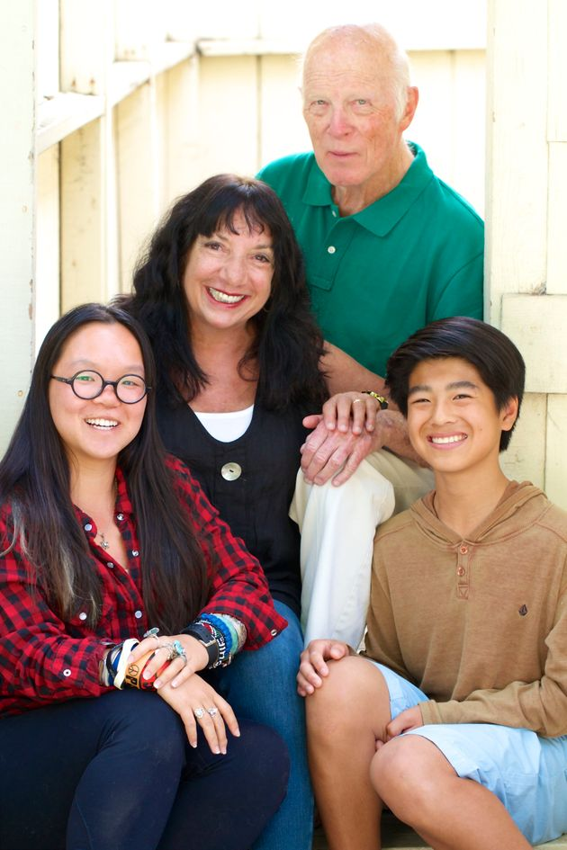
Promote Confidence, Claim, and Empower Your Children
“Teaching your children that they don’t need to be victims is empowering. I’ve taught my children how to respond to uncomfortable comments when they hear them by my own responses. Sometimes I just ignore and sometimes I teach in a non-hateful way.”
-Ann Brenoff, Mother of two children adopted from China
Notes:
READ THE QUOTE
"Teaching your children that they don't need to be victims is empowering. I've taught my children how to respond to uncomfortable comments when they hear them by my own responses. Sometimes I just ignore and sometimes I teach in a non-hateful way."
--Ann Brenoff, Mother of Two Children adopted from China
What do you do (or what should your children do) When others ask intrusive and uninvited questions, when they ask why your family does not “match,” or ask inappropriate questions regarding race and adoption in front of your children? This can be an invitation to education about adoption or a time to model setting limits on the intrusion. Often these questions can be racially charged and expose stereotypes and prejudice.
Reference Handout: Ready answers to intrusive questions

Slide 28
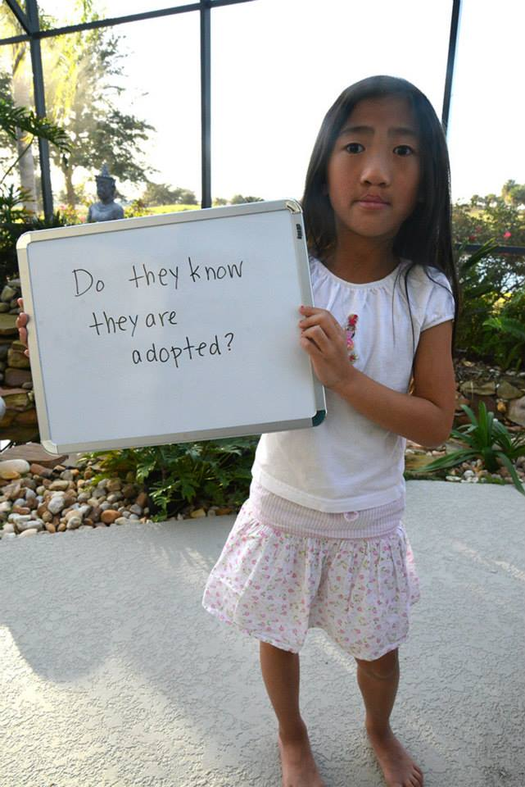
Ready Answers to Intrusive Questions
Why do you ask?
That is personal (or private).
Really? Seriously?
Did you mean to say? (Reword and Redo)
Repeat the question.
Humor
Using claiming words.
You need to ask my parents.
Notes:
In responding to uncomfortable questions, remember your child is watching and learning. Many people don’t mean to be hurtful or rude, they just don’t know about adoption. Rehearsing scripts helps equip your family to respond to questions that might otherwise have left you speechless.
Here are some options of how you can respond, when faced with difficult, intrusive questions. What an adult can get away saying, may not be how a child should be responding to an adult so be mindful of that fact.
Why Do you Ask?. These questions may be a chance to educate folks on adoption. If a person means well, be gracious and educate them. Question: “Are you her REAL mom?” can be answered with “Yes, I am her real mom. If you mean her birth mom, well, that is personal and we don’t talk about it outside of our family.”
That is personal or private. You do not have to answer every question that someone has.
Really? Or Seriously? Or both. A one or two word response says it all without saying much. It gives the chance for the person to rethink the possibility that his question is not appropriate.
Reword the question for them, getting at the heart of the question with the right words. Example: How much did she cost? Response: Do you mean to ask how much does the adoption process cost? We did not pay for our children.
If you are at a loss for words, repeat their question back at them then breathe. You may also add, “Really? Seriously?” to help them understand that is not an appropriate and you won’t be answering their question.
Use humor: Example: Question “But what are her emotional issues”: Answer “Happy all the time, thank you!” and exit the exchange. Question: “Are you her “real mom?” Answer: “No I am her fake mom, I am plastic, can’t you tell!?”
Use claiming words. These interactions are a great time to claim your child and promote family unity. Example: Is she your “real child?” Answer with enthusiasm, “Yes, she is, thank you!”
You need to ask my parents. An overall escape you can give your child.

Slide 29
Encourage Kids to Think T.I.P. !
Tell It,
Ignore It, or
Keep it Private
Notes:
Encourage your child to Use T.I.P. TIP is an easy ways to remember “Tell it, Ignore it or Keep it Private. “
Practice scripts, such as “Yes I am adopted, thank you.” Or model ignoring and walking away. Remind kids they don’t have to answer every question that is asked. They can state, “That is private, thank you.” or “We don’t share that with people outside our family.” or “That is personal.” Most people will take the hint.

Slide 30
Group Activity: How would you teach your child to respond?
Notes:
ACTIVITY: Chat Box
We are going to go over several examples of intrusive questions a child might be asked. For this activity, I would like you to come up with a response to the question from a peer of their own age. And put in the chat box.
NOTE: Tell the participants to remember the previous slide’s suggested responses to prompt the participants to answer and remind them about TIP (Tell it, ignore it or Keep it Private.)
(Proceed to the questions on each slide. Go through as many as you have time for or if the group is interested in more examples).
**********************************************************************************

Slide 31
Where are your real parents?
Why don’t you look like your
Mom?
To a 10 year old
To a 4-year-old old transracial child
Did your parents do drugs?
Why did your parents give you
away?
To a 12 year old
To a 10 year old
Notes:
Where are your real parents? (10 years old) Right here. Why do you ask? What are fake parents anyway? My parents are real, thank you. You mean my birth parents—that’s personal.
Did your parents do drugs? (12 years old) None of your business. That’s kind of personal. Do Yours?
Why don’t you look like your Mom? (4 years old transracial child) Because I’m adopted. Families don’t have to look alike. Do I have to be? Families don’t have to match.
Why did your parents give you away? (10 years old) Why do you Ask? That’s Personal, You Have to Ask my Parents. What are you talking about? My family does have me!
Have each group respond and invite others to give additional responses.

Slide 32
Why didn’t your parents fight
for you?
How come you live with your
Grandparents?
To a 13 year old
To a 7 year old
What are some things that people
Have said/asked you?
Notes:
Why didn’t your parents fight for you? (13 years old) How do you know they didn’t? Why do you ask? That’s personal, man. They had a lot a lot of problems dude and it didn’t work out. But I have great parents now.
How come you live with your grandparents? (7 years old) That’s private. Why do you want to know? Just because. I just do (and then walk away.)

Slide 33
Review of Identity Tasks
1. What is my adoption story? Who am I? What happened to me?
2. Does my voice matter and have power? Is it safe to try and fail?
3. Who am I racially & culturally? What if I’m different than my parents?
4. How do I respond to others when they ask me about adoption?
Notes:
That brings us to the end of our look at Identity in Adoption. To review what we covered today, we looked at four facets of Identity in Adoption.
The first addressed the question -- What is my personal adoption story? Who am I and what happened to me?
The second looked at the area of Mastery and Control—does my voice matter? Can I make an impact on the world?
The third briefly looked at the area of helping children develop a positive cultural and racial identify, especially if their race is different than your own.
And the final task was to look at tools to address the questions that both children and parents receive about adoption and possible racial or visual differences.

Slide 34
Questions, Comments, or Observations?
Notes:
Ask for any final questions or additional comments or observations.

